Slide 1
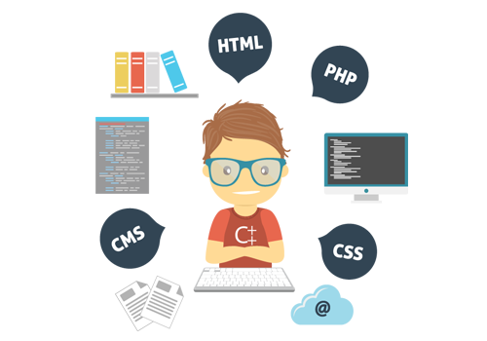
Skills you need as a programmer
Wladymir Brborich
Heavily Borrowed From: TechLead’s video: https://www.youtube.com/watch?v=3MtrUf81k6c&t=0s&index=45&list=WL

Slide 2



The obvious ones
Being proficient on a programming language
Problem Solving
Communication Skills
English
A bit of math is never bad

Slide 3

SQL
Structured Query Language
The “information language”
Crucial to interact with databases in a “pro” level
Data metrics are very important
Analyze and gather information
Measuring data impact, creating dashboards

Slide 4

Debugging Skills
The art of tracking down errors
You could spend an awful amount of time stuck on an algorithm if you don’t know what is wrong with it.
Problem solving, learn how to quickly identify where bugs may be

Slide 5

Scripting and tooling
Create tools for yourself
Who better to satisfy your needs than yourself
Speed up your workflow, and your every day tasks
Learn a scripting language, Python, Bash, JavaScript, GoLang
Be friends with the Terminal

Slide 6

Anti-Social Skills
Be productive
Writing emails, creating Wiki pages, Readme for your code
Setting presentations
Notes, Spreadsheets
Now your place while you are working
Preserve knowledge, conversations, keep everybody posted

